Slide 1
Section 4 Time Series Overview

Slide 2
Time Series Summary
Time Serie definitions :
it’s an ordered sequence of values of a variable at equally spaced time intervals
it’s a notion of a real world event as an observation of sequence of timely activities
Time Series are everywhere in all industries :
Climate, Weather, economics, Physics, marketing, sales, ….
Time Series are analyzed for Classification & prediction :
anomaly detection, feature extraction, classification, and to predict next values based on historical values.
HeartBeat classification
Stock price prediction

Slide 3
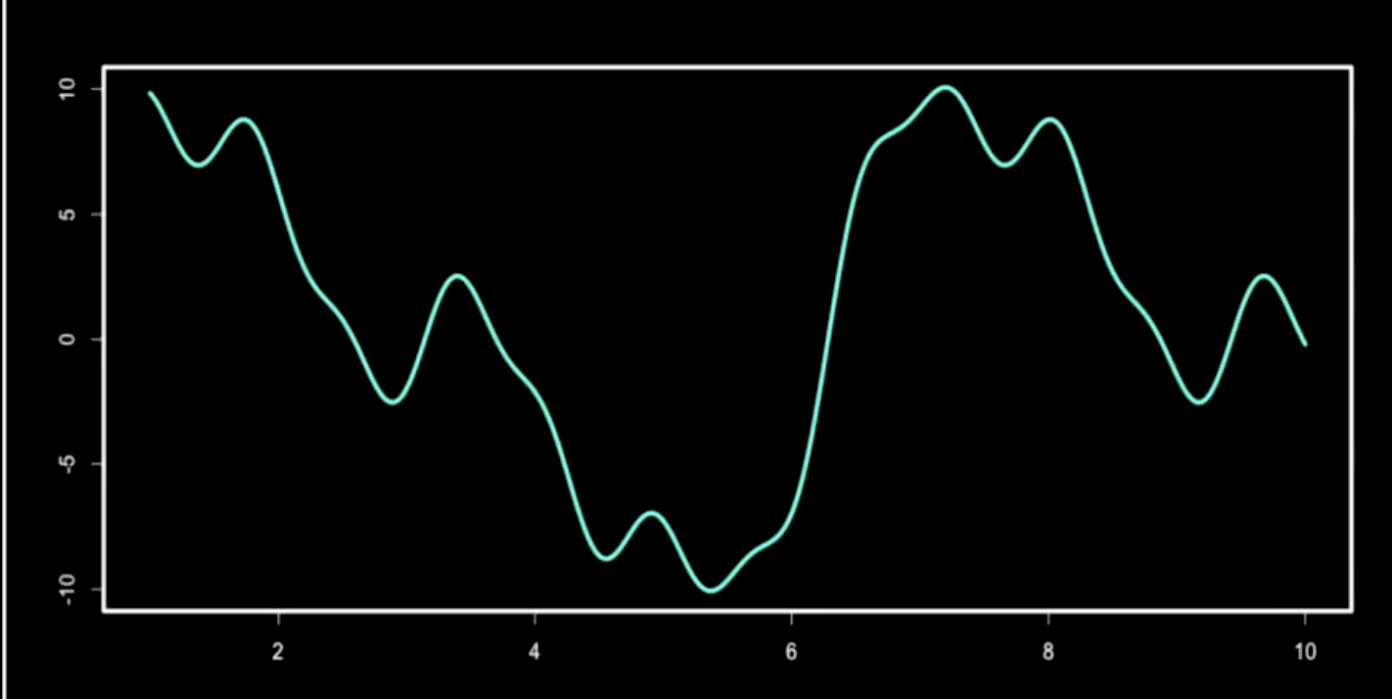
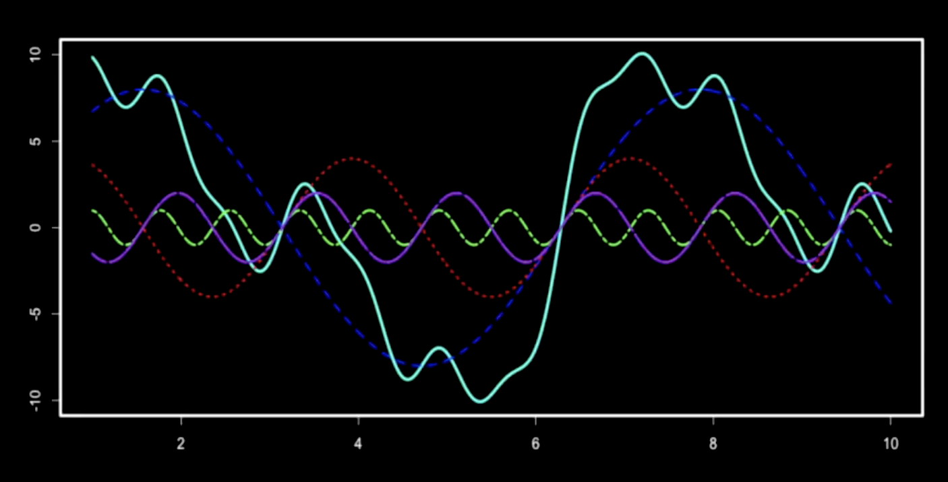
Time Series con’t
If a Time Serie is a time function reasonably continuous & periodic then it can be expressed as the sum of a series of sine terms.
Therefore Discrete-time Fourier transform (DTFT) & Fast Fourier Transformation (FFT) are very efficient methods to model & predict its.

Slide 4
Time Series con’t
Time Series that aren’t continuous can be considered as sequences.
Decomposition is key to analyze time series
Trend – overall direction of the series i.e. upwards, downwards etc.
Seasonality– monthly or quarterly patterns
Irregular remainder :
random noise left after extraction of all the components
Univariate or mulitvariate

Slide 5
Time Series Algorithms
Future values are predicted from previous
ARIMA ("Auto- Regressive – Integrated – Moving Average by Box et Jenkins (1976).
Auto-Regressive : (p) Every point can be predicted by the weighted sum of previous points + random Error
Integrated : (d) each point is distant from the previous by an equal constant
Moving Average : (q) each point can be predicted by average previous ones + Error rate.
Prophet (https://research.fb.com/prophet-forecasting-at-scale/).
It’s an additive regression model with four main components:
A piecewise linear or logistic growth curve trend. Automatically detects changes in trends by selecting changepoints from the data.
A yearly seasonal component modeled using Fourier series.
A weekly seasonal component using dummy variables.
A user-provided list of important holidays.
ANN (Artificial Neural Networks)
RCNN (Recurrent Neural Network)
See this article on Recurrent Neural Networks for Multivariate Time Series https://www.nature.com/articles/s41598-018-24271-9
LSTM (Long Short Term Memory)
See this Kaggle tutorial https://www.kaggle.com/amirrezaeian/time-series-data-analysis-using-lstm-tutorial
https://en.wikipedia.org/wiki/Additive_model

Slide 6
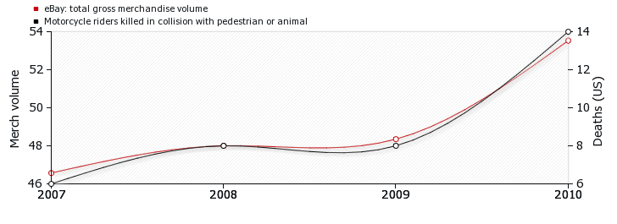
Caveats
Correlation doesn’t means causality
http://tylervigen.com/spurious-correlations

Slide 7
Lab 4 : Time Series prediction
An analyst for a national broadband provider is required to produce forecasts of user subscriptions in order to predict utilization of bandwidth.
Lab Material avaialble at https://ibm.box.com/v/WatsonStudio-WS
Instructions Hands-On Labs/Lab4-TimeSeries/Lab4_TimeSeries.pdf
File : Hands-On Labs/Lab4-TimeSeries/Broadband.csv

Slide 8
Thank You

Slide 9
Notices and Disclaimers
Copyright © 2016 by International Business Machines Corporation (IBM). No part of this document may be reproduced or transmitted in any form without written permission from IBM.
U.S. Government Users Restricted Rights - Use, duplication or disclosure restricted by GSA ADP Schedule Contract with IBM.
Information in these presentations (including information relating to products that have not yet been announced by IBM) has been reviewed for accuracy as of the date of initial publication and could include unintentional technical or typographical errors. IBM shall have no responsibility to update this information. THIS DOCUMENT IS DISTRIBUTED "AS IS" WITHOUT ANY WARRANTY, EITHER EXPRESS OR IMPLIED. IN NO EVENT SHALL IBM BE LIABLE FOR ANY DAMAGE ARISING FROM THE USE OF THIS INFORMATION, INCLUDING BUT NOT LIMITED TO, LOSS OF DATA, BUSINESS INTERRUPTION, LOSS OF PROFIT OR LOSS OF OPPORTUNITY. IBM products and services are warranted according to the terms and conditions of the agreements under which they are provided.
IBM products are manufactured from new parts or new and used parts. In some cases, a product may not be new and may have been previously installed. Regardless, our warranty terms apply.”
Any statements regarding IBM's future direction, intent or product plans are subject to change or withdrawal without notice.
Performance data contained herein was generally obtained in a controlled, isolated environments. Customer examples are presented as illustrations of how those customers have used IBM products and the results they may have achieved. Actual performance, cost, savings or other results in other operating environments may vary.
References in this document to IBM products, programs, or services does not imply that IBM intends to make such products, programs or services available in all countries in which IBM operates or does business.
Workshops, sessions and associated materials may have been prepared by independent session speakers, and do not necessarily reflect the views of IBM. All materials and discussions are provided for informational purposes only, and are neither intended to, nor shall constitute legal or other guidance or advice to any individual participant or their specific situation.
It is the customer’s responsibility to insure its own compliance with legal requirements and to obtain advice of competent legal counsel as to the identification and interpretation of any relevant laws and regulatory requirements that may affect the customer’s business and any actions the customer may need to take to comply with such laws. IBM does not provide legal advice or represent or warrant that its services or products will ensure that the customer is in compliance with any law

Slide 10
Notices and Disclaimers Con’t.
Information concerning non-IBM products was obtained from the suppliers of those products, their published announcements or other publicly available sources. IBM has not tested those products in connection with this publication and cannot confirm the accuracy of performance, compatibility or any other claims related to non-IBM products. Questions on the capabilities of non-IBM products should be addressed to the suppliers of those products. IBM does not warrant the quality of any third-party products, or the ability of any such third-party products to interoperate with IBM’s products. IBM EXPRESSLY DISCLAIMS ALL WARRANTIES, EXPRESSED OR IMPLIED, INCLUDING BUT NOT LIMITED TO, THE IMPLIED WARRANTIES OF MERCHANTABILITY AND FITNESS FOR A PARTICULAR PURPOSE.
The provision of the information contained h erein is not intended to, and does not, grant any right or license under any IBM patents, copyrights, trademarks or other intellectual property right.
IBM, the IBM logo, ibm.com, Aspera®, Bluemix, Blueworks Live, CICS, Clearcase, Cognos®, DOORS®, Emptoris®, Enterprise Document Management System™, FASP®, FileNet®, Global Business Services ®, Global Technology Services ®, IBM ExperienceOne™, IBM SmartCloud®, IBM Social Business®, Information on Demand, ILOG, Maximo®, MQIntegrator®, MQSeries®, Netcool®, OMEGAMON, OpenPower, PureAnalytics™, PureApplication®, pureCluster™, PureCoverage®, PureData®, PureExperience®, PureFlex®, pureQuery®, pureScale®, PureSystems®, QRadar®, Rational®, Rhapsody®, Smarter Commerce®, SoDA, SPSS, Sterling Commerce®, StoredIQ, Tealeaf®, Tivoli®, Trusteer®, Unica®, urban{code}®, Watson, WebSphere®, Worklight®, X-Force® and System z® Z/OS, are trademarks of International Business Machines Corporation, registered in many jurisdictions worldwide. Other product and service names might be trademarks of IBM or other companies. A current list of IBM trademarks is available on the Web at "Copyright and trademark information" at: www.ibm.com/legal/copytrade.shtml.

